Slide 1
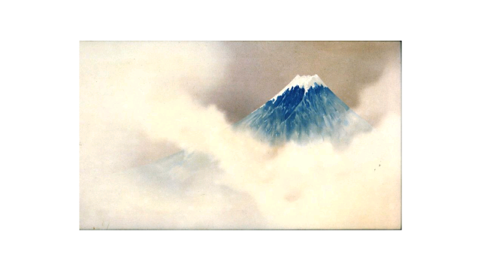
Japan: Arts and Culture
Margaret Barbee PhD
April 2019

Slide 2
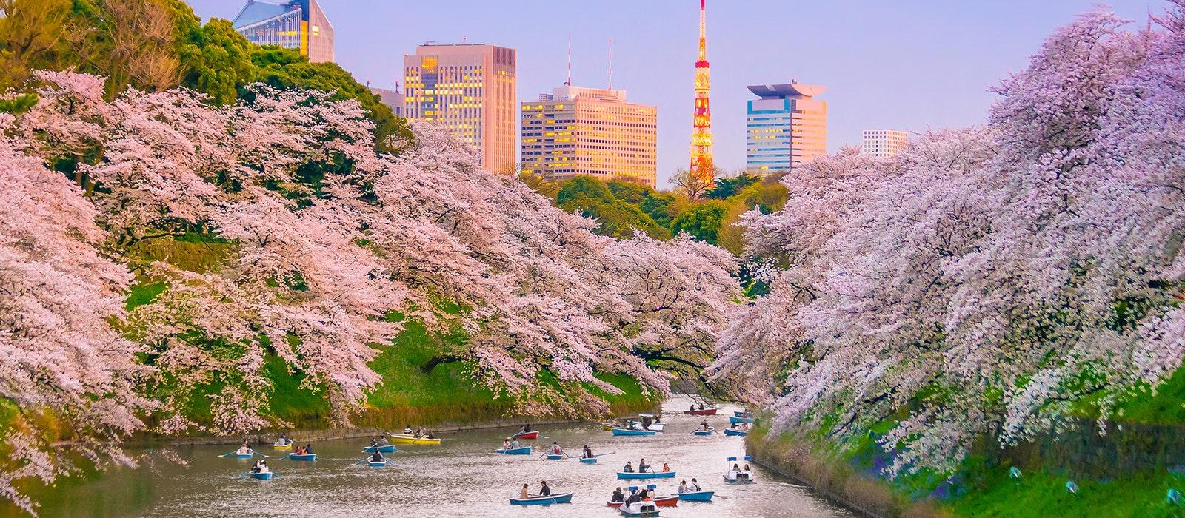
Design and Aesthetics

Slide 3
Language of Design
Wabi Sabi: rustic, withered, dreary
Shibui: subtle elegance
Shoin: a “study hall”
Sukia: abode of refinement

Slide 4
Language of Design Terms
Hade: bright
Iki: chic
Jimi: somber, proper
Miyabi: courtly elegance, opulent, lavish
Karei: sumptuous

Slide 5
“The blossom is the first embrace of oblivion…”
Japanese Design: Art, Aesthetics and Culture, by Patricia Graham

Slide 6
Design Characteristics
Refined
Graceful
Nature
Beauty
Detail
Tranquil, serene
Flexibility
Compact
Natural imperfections
Forms and structures
Transformational
Pleasurable

Slide 7
Typical Motifs
Flowers
Leaves and branches
Rocks
Water features
Birds
Colors
Metaphors and symbols

Slide 8
Forms and Patterns
Hierarchy and order
Dimensions of time and space
Boundaries
No waste of material, resources

Slide 9
Art Expression
Painting: ancient and modern
Food: cooking, serving and tea
Gardens: outdoor, interior, bonsai, ikebana
Poetry: haiku
Kimonos: silks, embroidery and textiles
Calligraphy
Ceramics

Slide 10
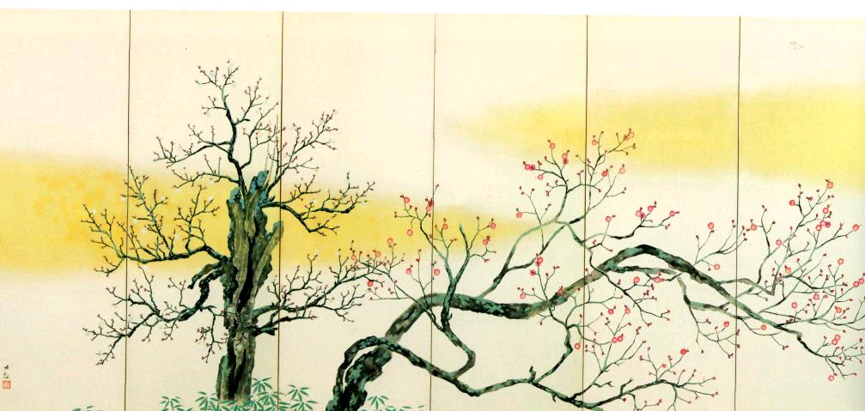

Slide 11
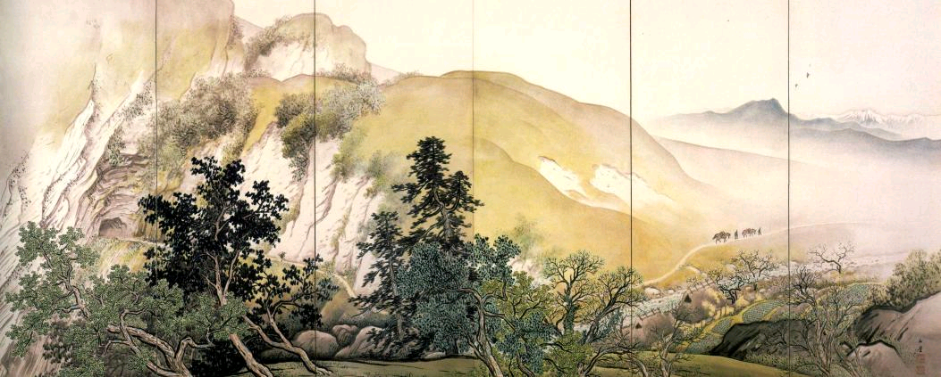

Slide 12
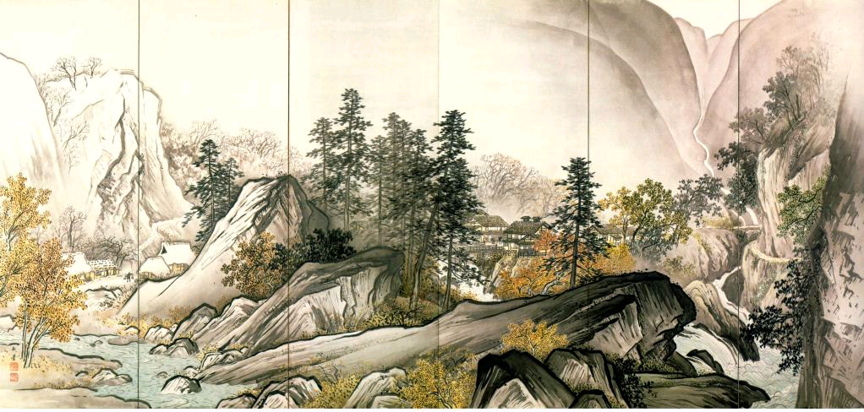

Slide 13
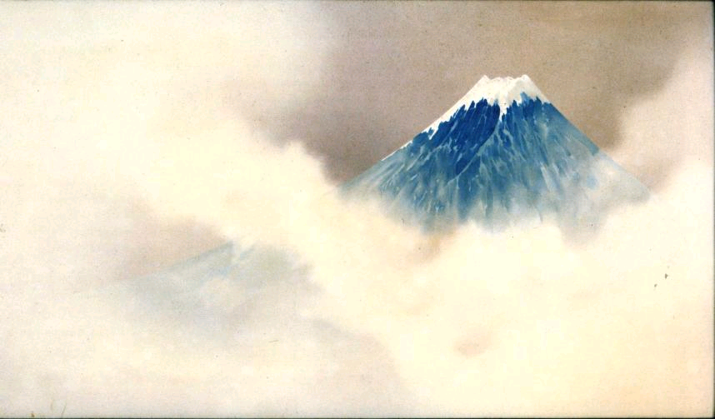

Slide 14
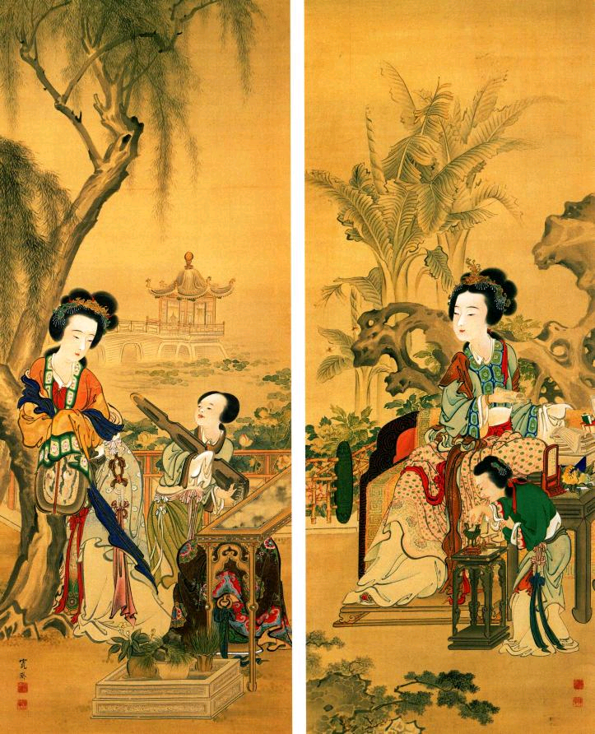

Slide 15
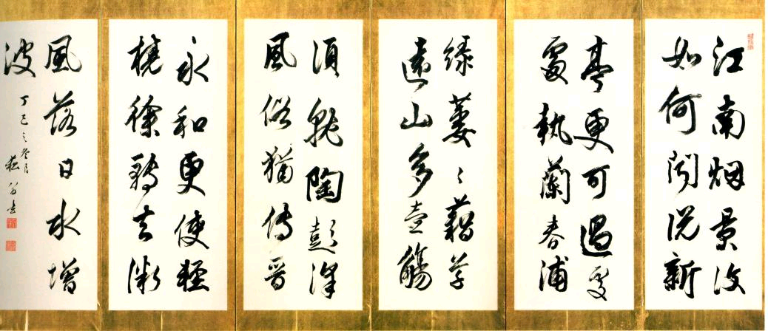

Slide 16
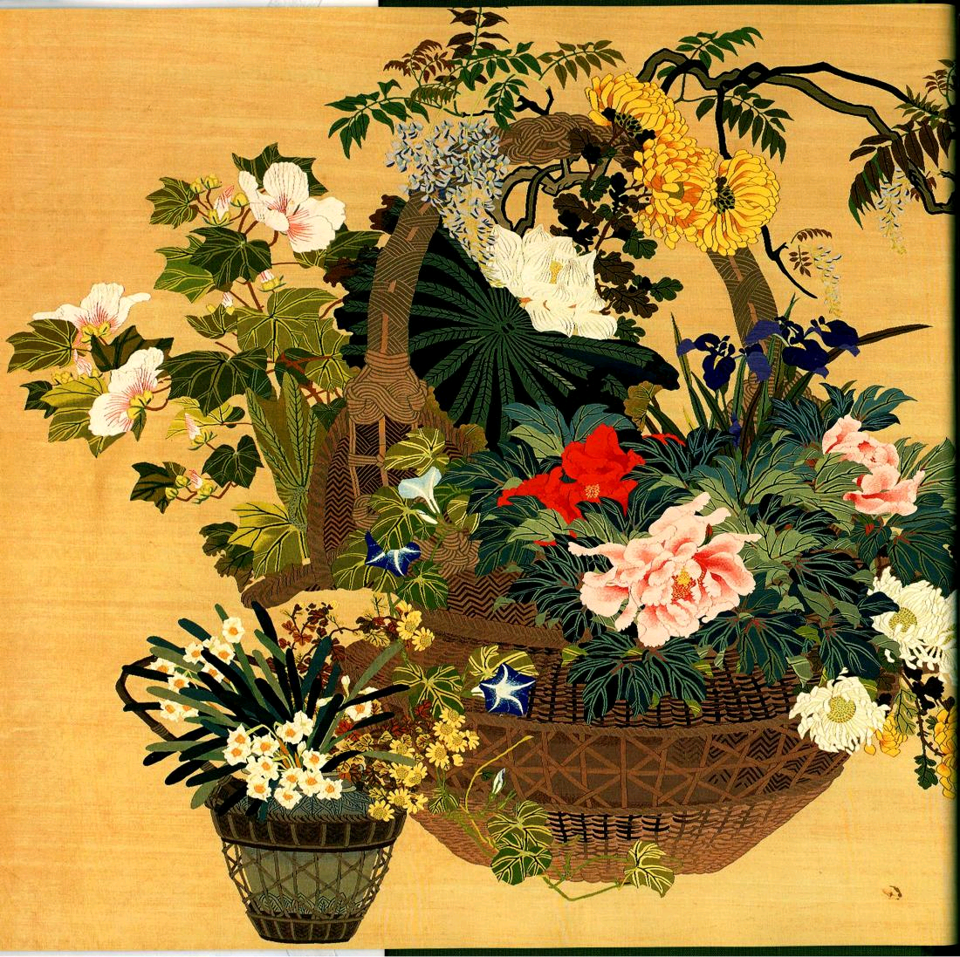

Slide 17
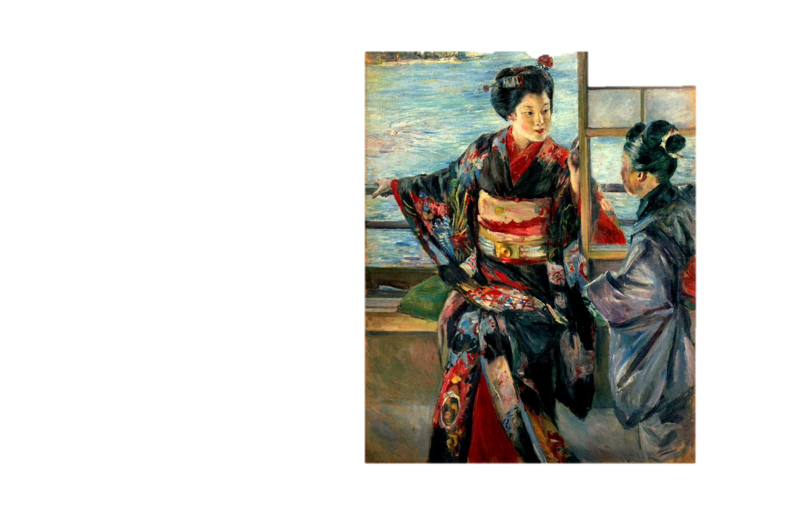

Slide 18
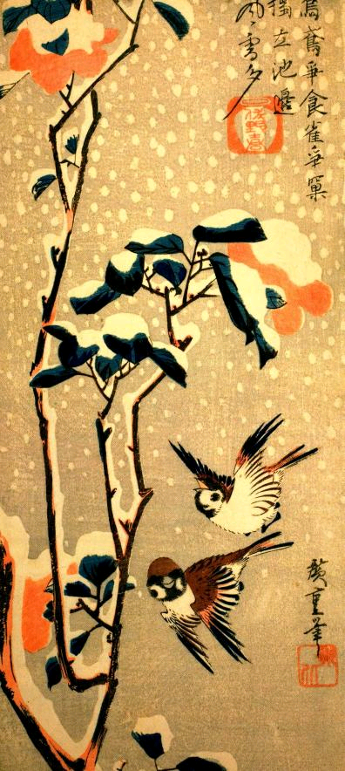

Slide 19
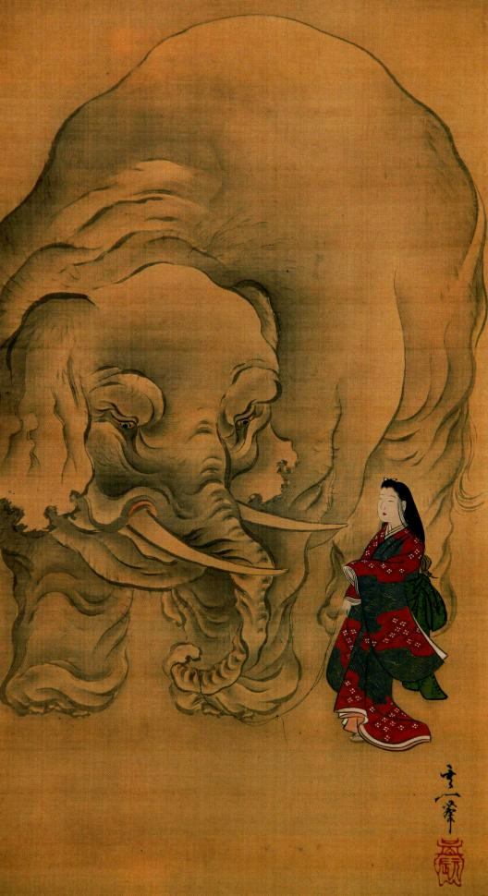

Slide 20
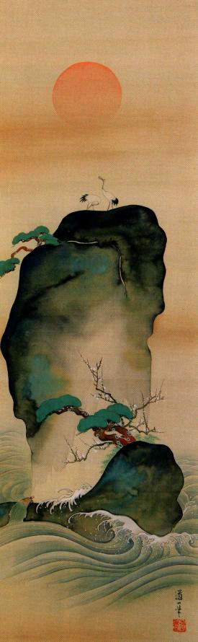

Slide 21
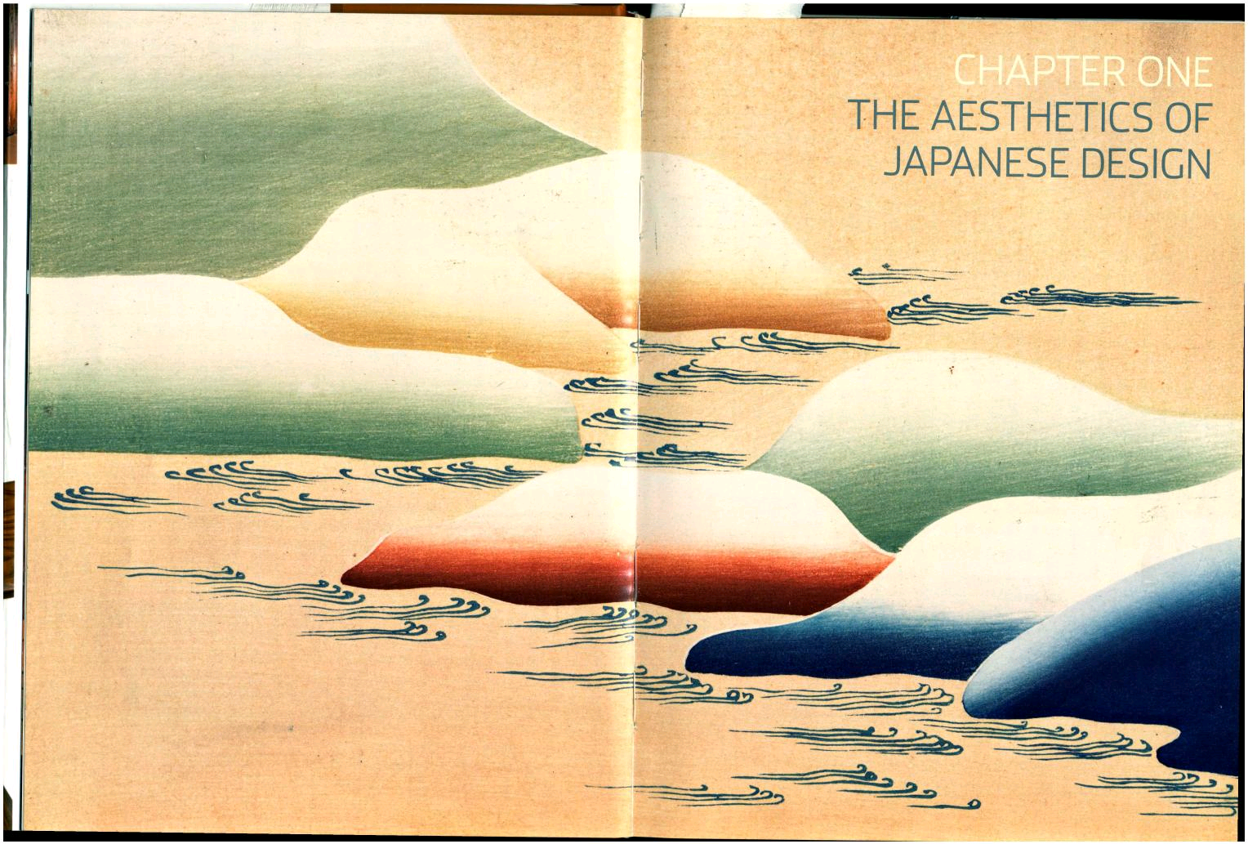

Slide 22
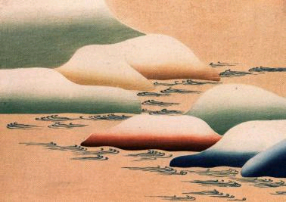

Slide 23
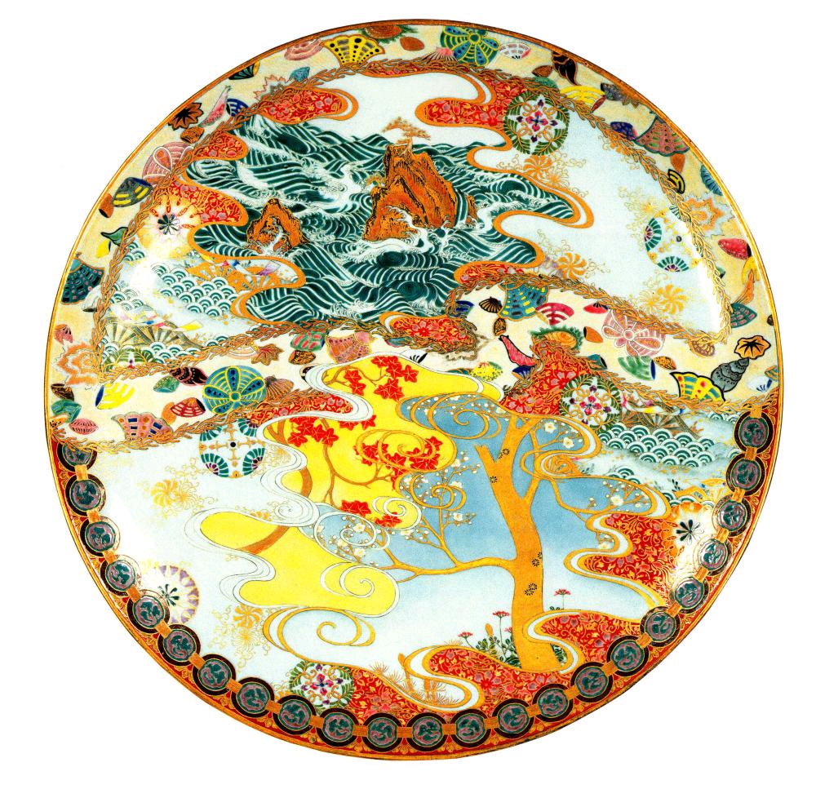
Ceramic
Plate

Slide 24
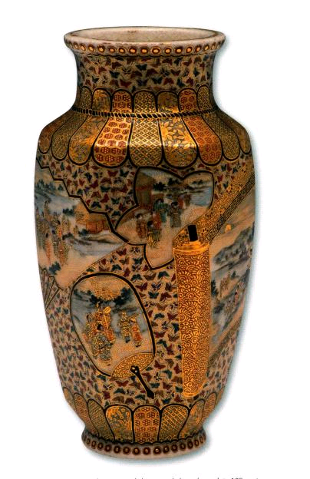

Slide 25
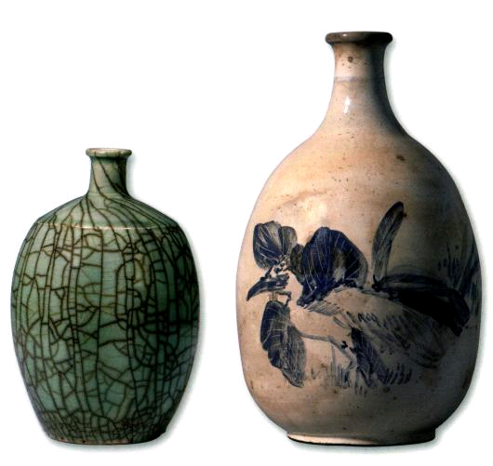

Slide 26
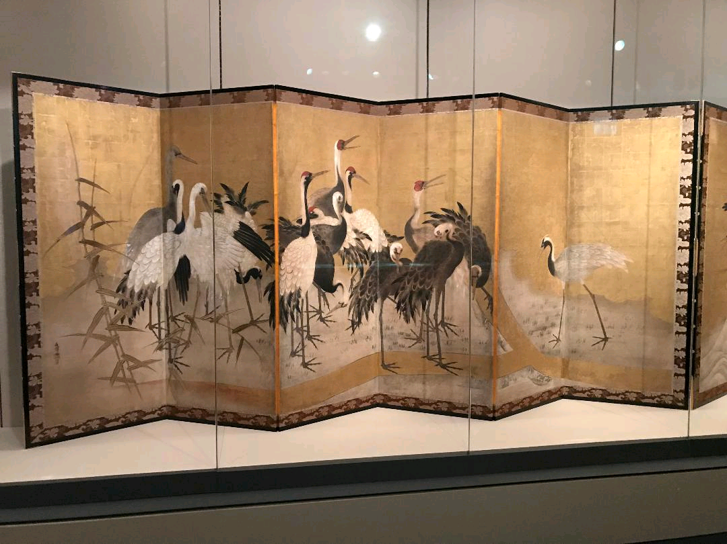

Slide 27
Haiku Poetry
Structure of 17 syllables
  Three lines: 5-7-5
  References natural world. Senryu, similar, not about nature
  No rhymes
  Ninth century until today
  Leaves a strong feeling or impression
  “In the moonlight the
  color and scent of wisteria
  seems far away”

