Slide 1
Windows 10 version 1903
Release due late May 2019

Slide 2
Which version of Windows am I running now?
Microsoft issues security updates for only 18 months after a new version is released
If you are running version 1703 or older, you need to update if you are using your computer for financial transactions or online purchases

Slide 3
Do I care which version of Windows 10 is on my computer?
From the Windows search box or Cortana, type WINVER
Or from a Command prompt (DOS prompt), type WINVER.EXE
Current Windows version is 1809. Previous versions are: 1803, 1709, 1703, 1511, 10

Slide 4
Is it OK to still run Windows 7?
From the Windows search box or Cortana, type WINVER
Or from a Command prompt (DOS prompt), type WINVER.EXE
Current Windows version is 1809. Previous versions are: 1803, 1709, 1703, 1511, 10

Slide 5
System requirements for Windows 10 version 1903
Processor: 1GHz or faster CPU
Memory: 1GB for 32-bit or 2GB for 64-bit
Hard drive space: 32GB
System reserve partition 100 MB or larger
Graphics: DirectX 9 or later with WDDM 1.0 driver
Display: 800×600 or higher

Slide 6


Slide 7
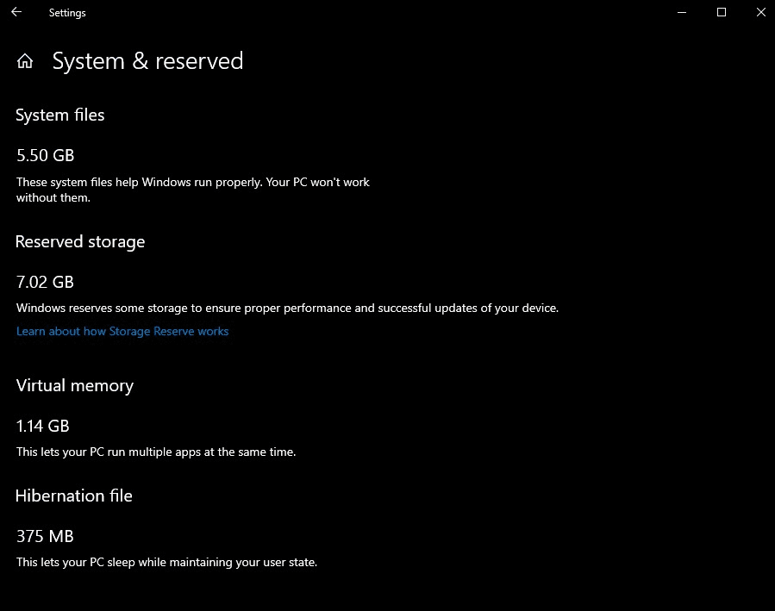
Reserved storage

Slide 8

Windows 10 Pro sandbox

Slide 9
Windows search
Separated from Cortana
Can control which folders get indexed
  (Settings / Search / Searching Windows)
Easier to turn off indexing
Link to phone for seamless transitions

Slide 10
Getting the search box back
To reinstate the search box in Windows 10, follow these steps:
Right-click on taskbar running across the bottom of the screen
Select Cortana / Show search box
(note that this method will likely no longer work in version 1903 of Windows)

Slide 11


Snipping tool
Name has changed to Snip & Sketch
Can now save as JPG and GIF, not just PNG

Slide 12
Look and feel
More icons in taskbar (mike, brightness, etc.)
Automatic scaling for blurry apps
Can sign in with Face ID, fingerprint, PIN, or phone, in addition to password
Easier to change mouse cursor size and color
Default to conversational dates (5 hours ago) in File Explorer
  Can revert to normal dates (5/3/2019)

Slide 13
For more info on version 1903
https://youtu.be/YcP1hhej5So?list=PL-9Q_DnVzAVVyiDqReRCNrzVEAgC4-0bJ
https://pureinfotech.com/windows-10-1903-19h1-april-2019-update-features/

Slide 14
Speeding up or cleaning up computer
Run MSCONFIG
On the Services tab, check box to hide all Microsoft services. Un-check things you don’t need
On the Startup tab, click on Start Task Manager, and un-check things you don’t need
Under Control Panel, go to Programs and uninstall programs you don’t need. Be careful – some of these programs may be necessary for sound, WiFi, or other essential functions
Delete printers that you no longer use

Slide 15
New computer preparation
On any new computer, install:
Adobe Reader
  (from www.adobe.com and go to bottom
  center of page)
Google Chrome
    (from chrome.google.com)
Most people also will want Java
  (from www.java.com)

Slide 16
Devirusing Google Chrome
Click on triple-dot menu in upper right corner
Click on More tools / Extensions
Keep extensions from Adobe, Google. Also keep HTTPS Anywhere.
Remove extensions referencing mail, security, maps, or anything else.
From triple-dot menu, go to Settings. Make sure search engine and startup pages are OK.

Slide 17
Backup and password
Please read and follow suggestions on Sue’s Backup Bible
www.suekayton.com/backupbible.htm
Write down all your usernames and password – and don’t forget your phone unlock code. Put a copy in your safe deposit box, a copy with your will/trust, and give a copy to a trusted friend or family member.
Back up your important files offsite, such as using Google Drive automatic backup

Slide 18
Google Photos
Free unlimited backup of photos and videos
Can tag photos for inclusion in one or more albums
Easy to share albums with individual people or public
Photos are sorted by date, and cannot be organized into folders
Easy to set up automatic backup of photos from cell phone or computer

Slide 19
Digitizing photos, movies and slides
I recommend using Costco. They do a quality job, it’s very cheap, and they have fast turnaround.
www.costcophotocenter.com
Put groups of photos or slides into a shoebox and put a paper inside with the name of the group. They will burn them onto a disk and will label it with the name you have chosen.

