Slide 1
Making
Windows 10
Work For Me
Sue Kayton November 2016

Slide 3
What is different
Some names
Desktop icons
Start menu
Internet Explorer
Microsoft Edge
Search (Cortana)
Picture viewer
Games
Crash recovery
Safe mode

Slide 4
New names
This PC (was My Computer)
Microsoft Edge (was Internet Explorer)
PC settings (Windows 10 control panel)
Windows update – moved to PC settings

Slide 5
Desktop

Slide 6
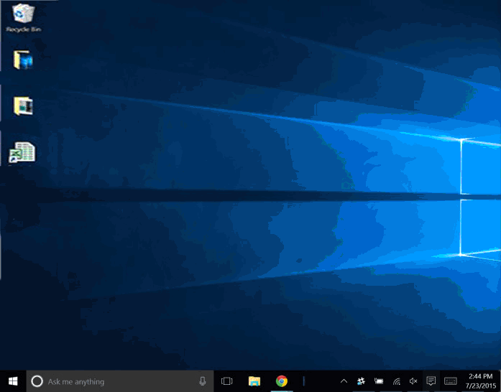

Slide 7
New icons
Task view
File
Explorer
Store -
Buy and
download apps
Microsoft Edge
replaces
Internet Explorer

Slide 8
Start menu

Slide 9
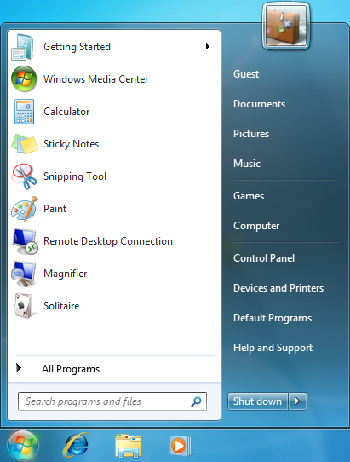
Where did my start button go?

Slide 10
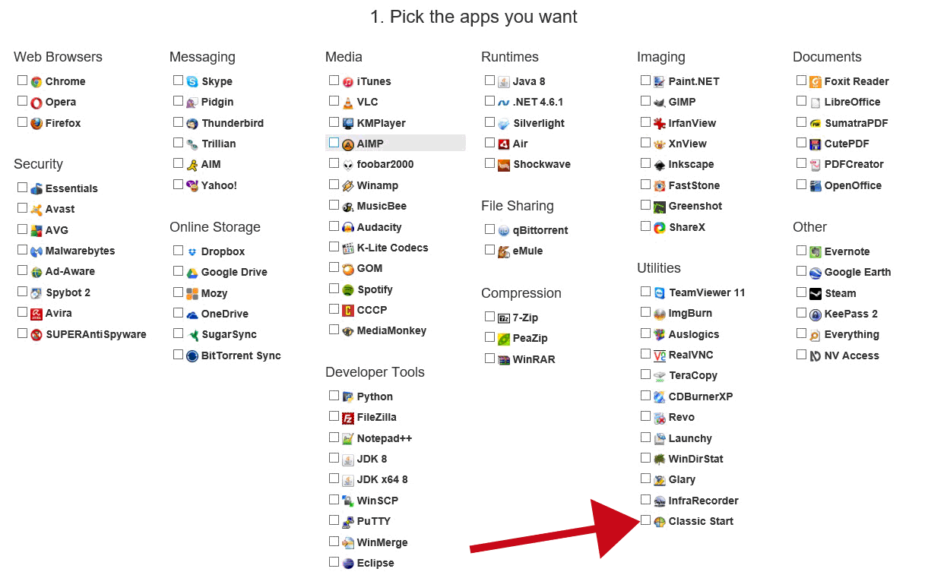

Slide 11
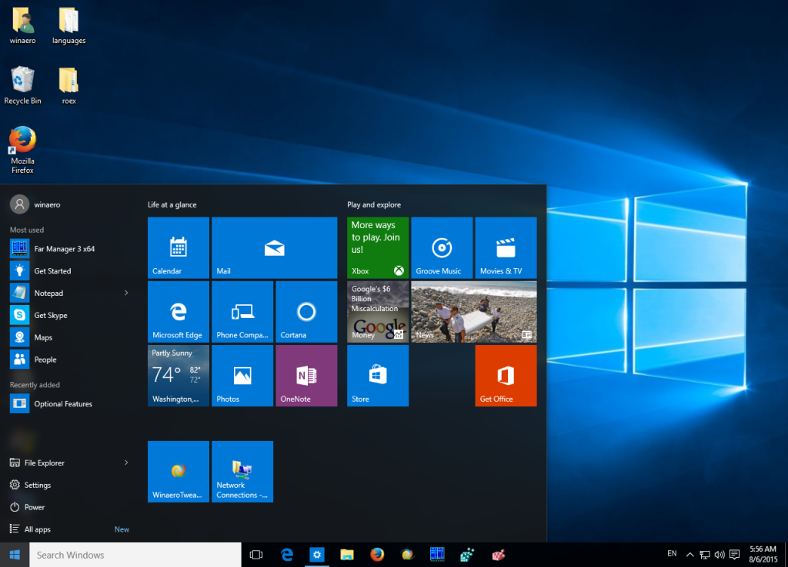

Slide 12
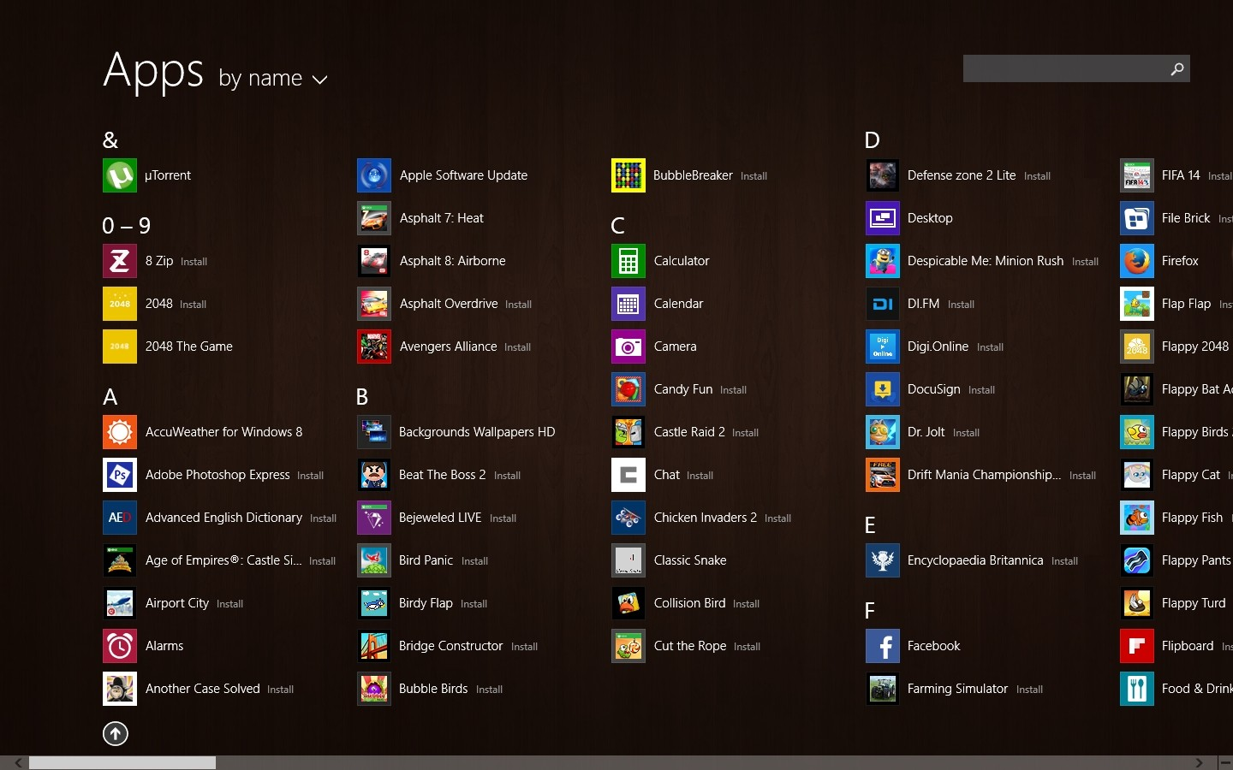

Slide 13
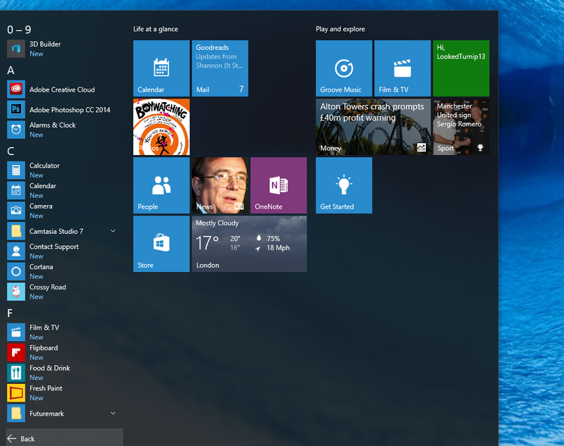

Slide 14
Microsoft Edge

Slide 16
Default programs

Slide 17
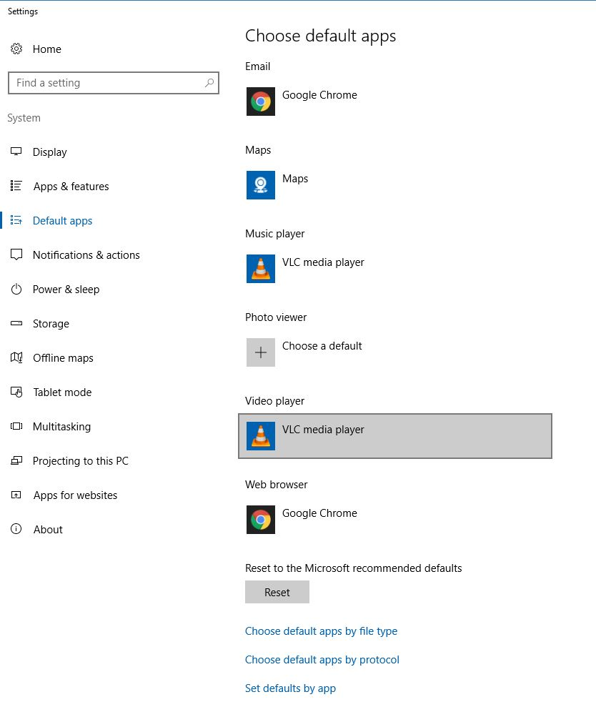

Slide 18
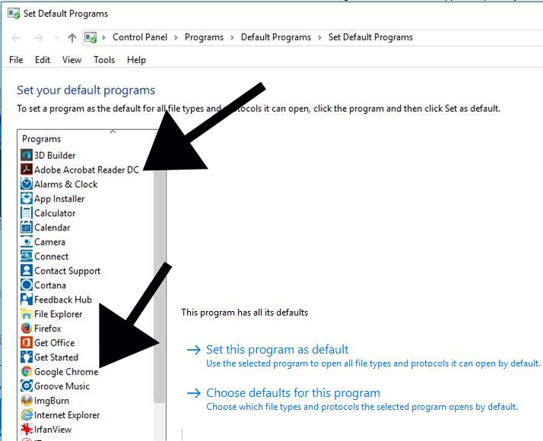

Slide 19
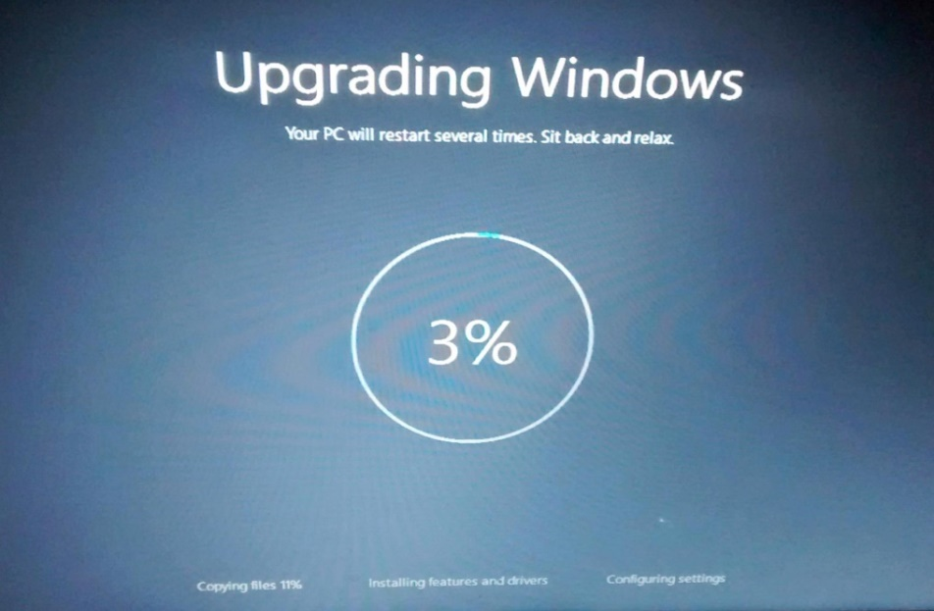
Windows 10 major upgrade
Major upgrades twice a year
Computer becomes unusable for two hours
No notification or warning
Start menu changes
Games disappear

Slide 20
Remove clutter
Remove un-needed items from:
Desktop
Taskbar
Start menu
Turn off OneDrive
Turn off notifications

Slide 21
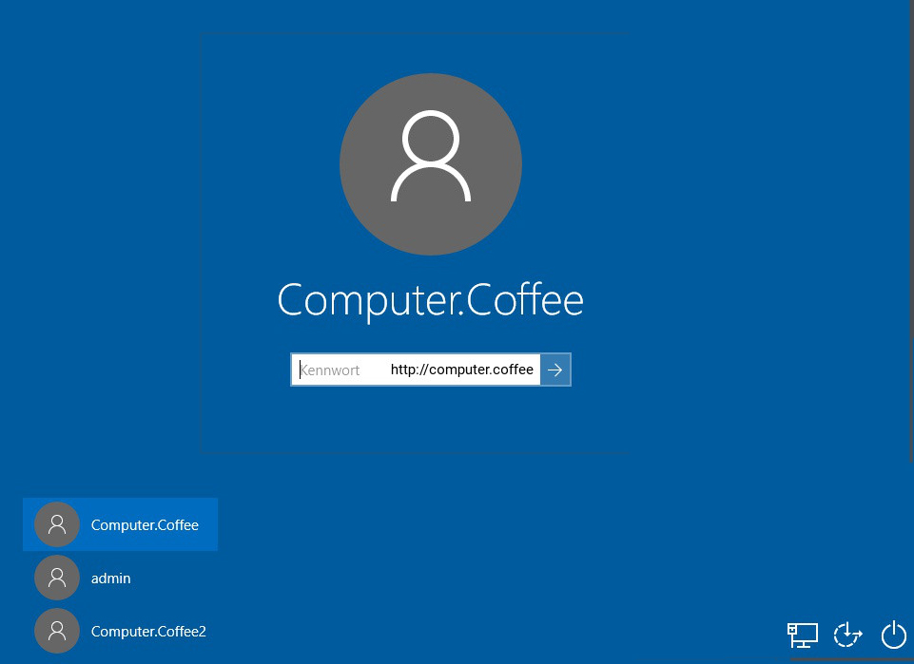
Log in screen

Slide 22
Local or Microsoft login
Local login
Easier to trouble-shoot and repair
Can use blank password
Can automatically log in
Microsoft login
Sync to OneDrive, LiveMail and Outlook.com
Can get locked out of computer
MUCH harder to trouble-shoot
Cannot use blank password

Slide 23
Windows games
FreeCell, Solitaire, Minesweeper still available
Have to re-install after every service pack (build) upgrade, about twice a year

Slide 24
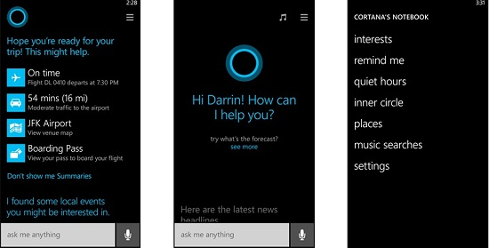
Cortana personal assistant

Slide 25
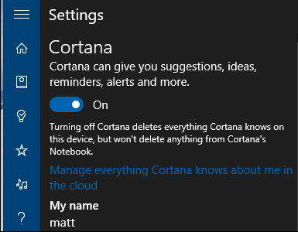
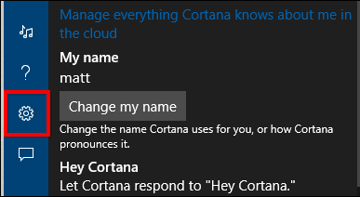
Cortana personal assistant

Slide 26
Enabling safe mode on boot
Safe Mode needed to recover from bad drivers, virus infestation, etc.
From elevated command prompt:
bcdedit /set {bootmgr} displaybootmenu yes bcdedit /timeout 2 bcdedit /set {default} bootmenupolicy legacy

Slide 27
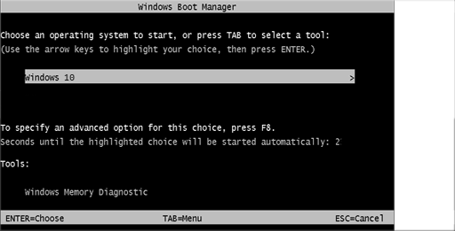
Enabling safe mode on boot
Hit F8 when you see this screen

Slide 28
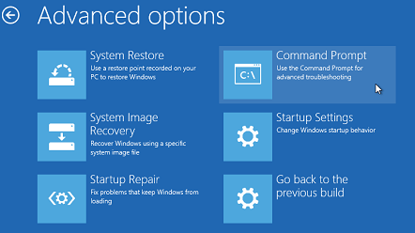
Recovery environment
Hold down shift key while restarting
If can’t boot, may launch automatically

Slide 29
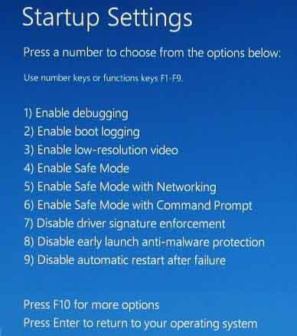

Slide 31
Back up !!
Back up data
Back up your system
Make a system
repair drive

Slide 32
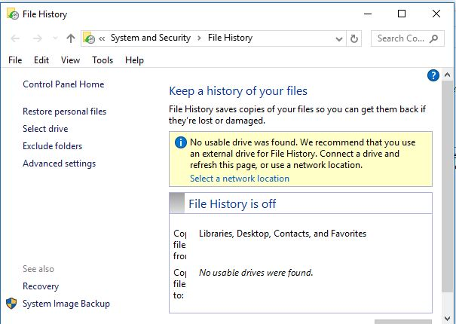
System image back up

Slide 33
Data back up
Cloud backup
Google Drive
DropBox
Local backup
Manual drop-and-drag
Third-party software (GFI)
Built in software in Windows 10

Slide 34
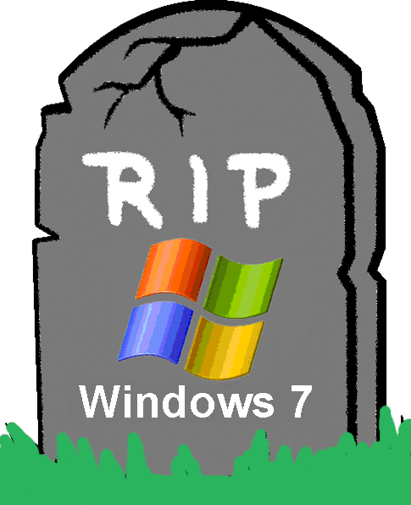
The future of Windows 7
Windows 7 security updates end January 2020
Windows 7 Pro OEM sales end October 31, 2016
Software vendors will stop support soon

Slide 35
To learn more
My website
www.suekayton.com
click on Windows 10 update
Tom’s Guide to Windows 10
http://www.laptopmag.com/t/windows

